Slide 1
School Carbon Footprint Web and Mobile app
A.S.F.Zuhra Nadtha
Grade 10
KM/Mahmud Ladies College, Kalmunai

Slide 2
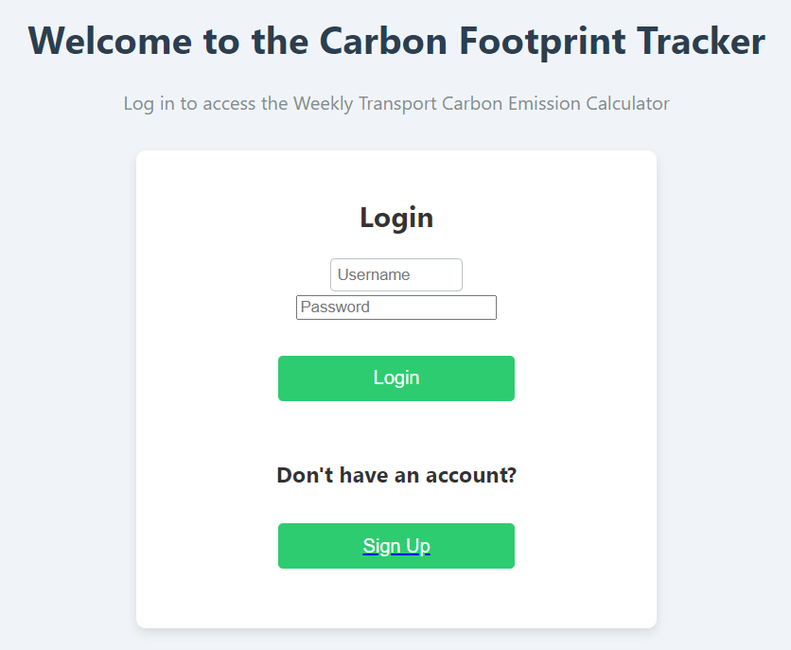
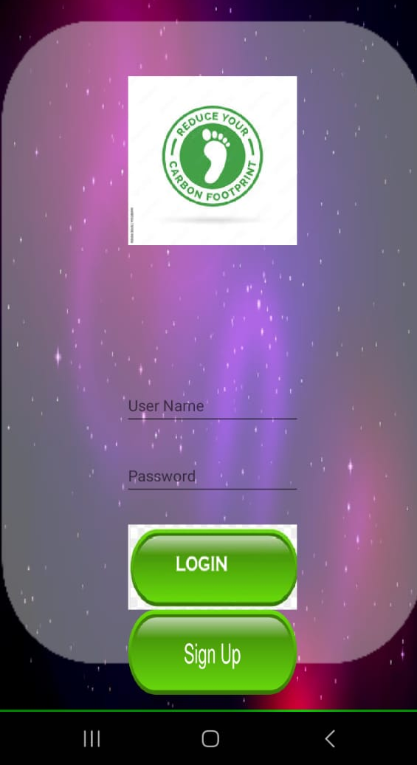
Objective of my innovation: This mobile app and web will help the schools to calculate their own carbon footprint of student transportation
https://jone85140.github.io/carbon-/new.html

Slide 3
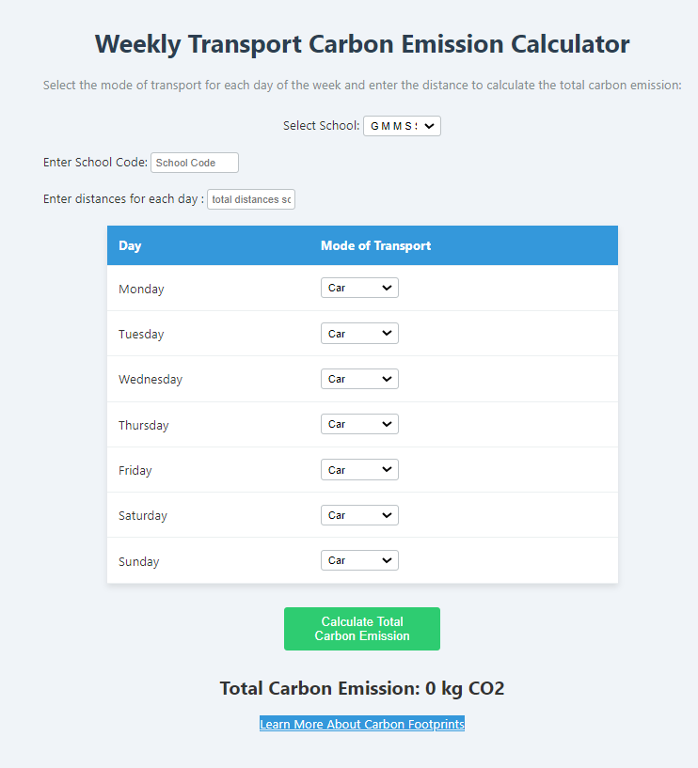
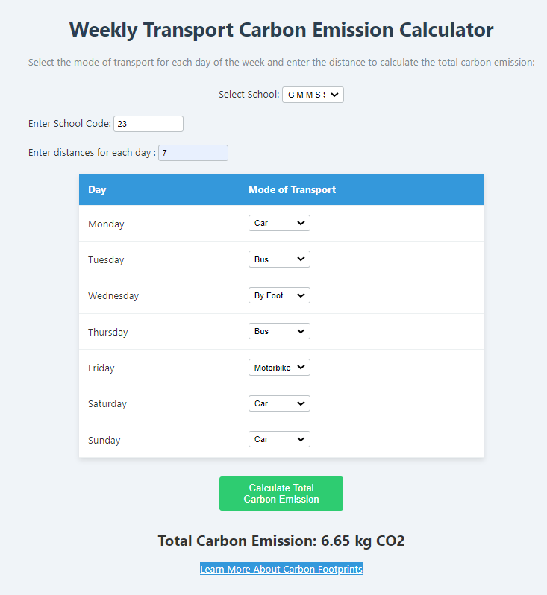
Novelty and Innovation

Slide 4
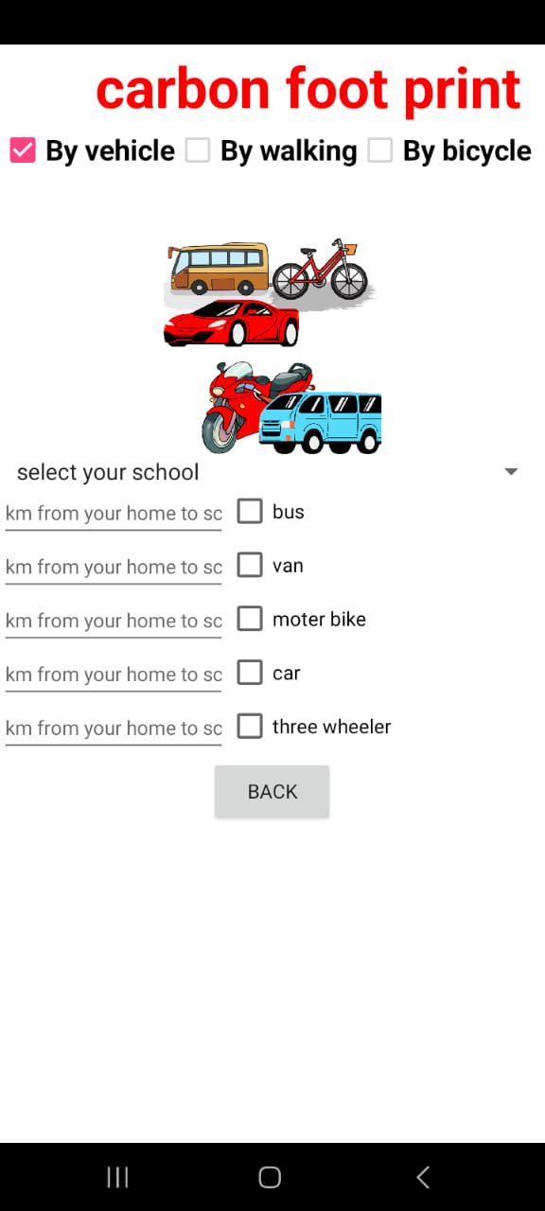
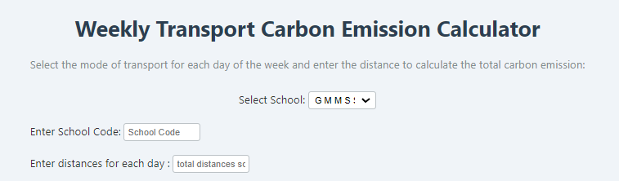
Novelty and Innovation

Slide 5
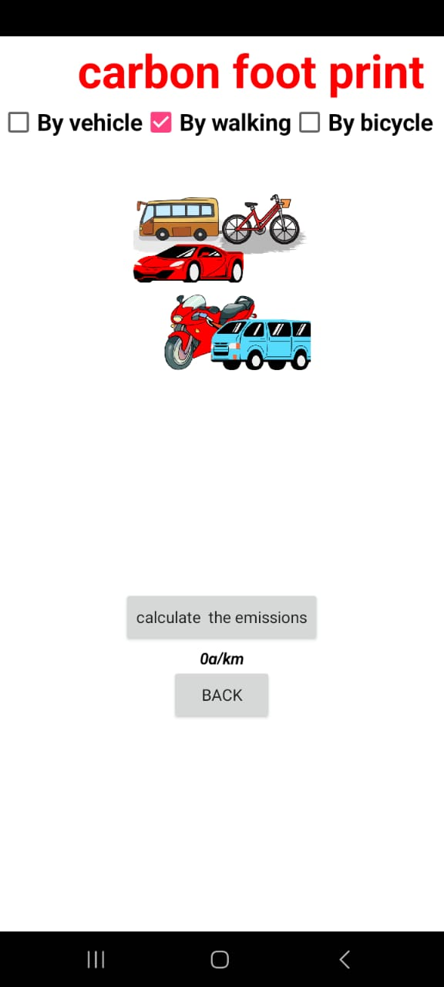
Novelty
and
Innovation

Slide 6
Target audience
Schools
It will promote competition among the schools to reduce carbon footprint by promoting low carbon transport mode among students
Students
Students will contribute to reduce carbon emission. They can compensate activities that can absorb carbon such as planting trees for their amount of carbon emission.

Slide 7
Ongoing further development
Generating Final Carbon Footprint Report for each school
Display it in a web graph
Launch competition among schools

